Slide 1
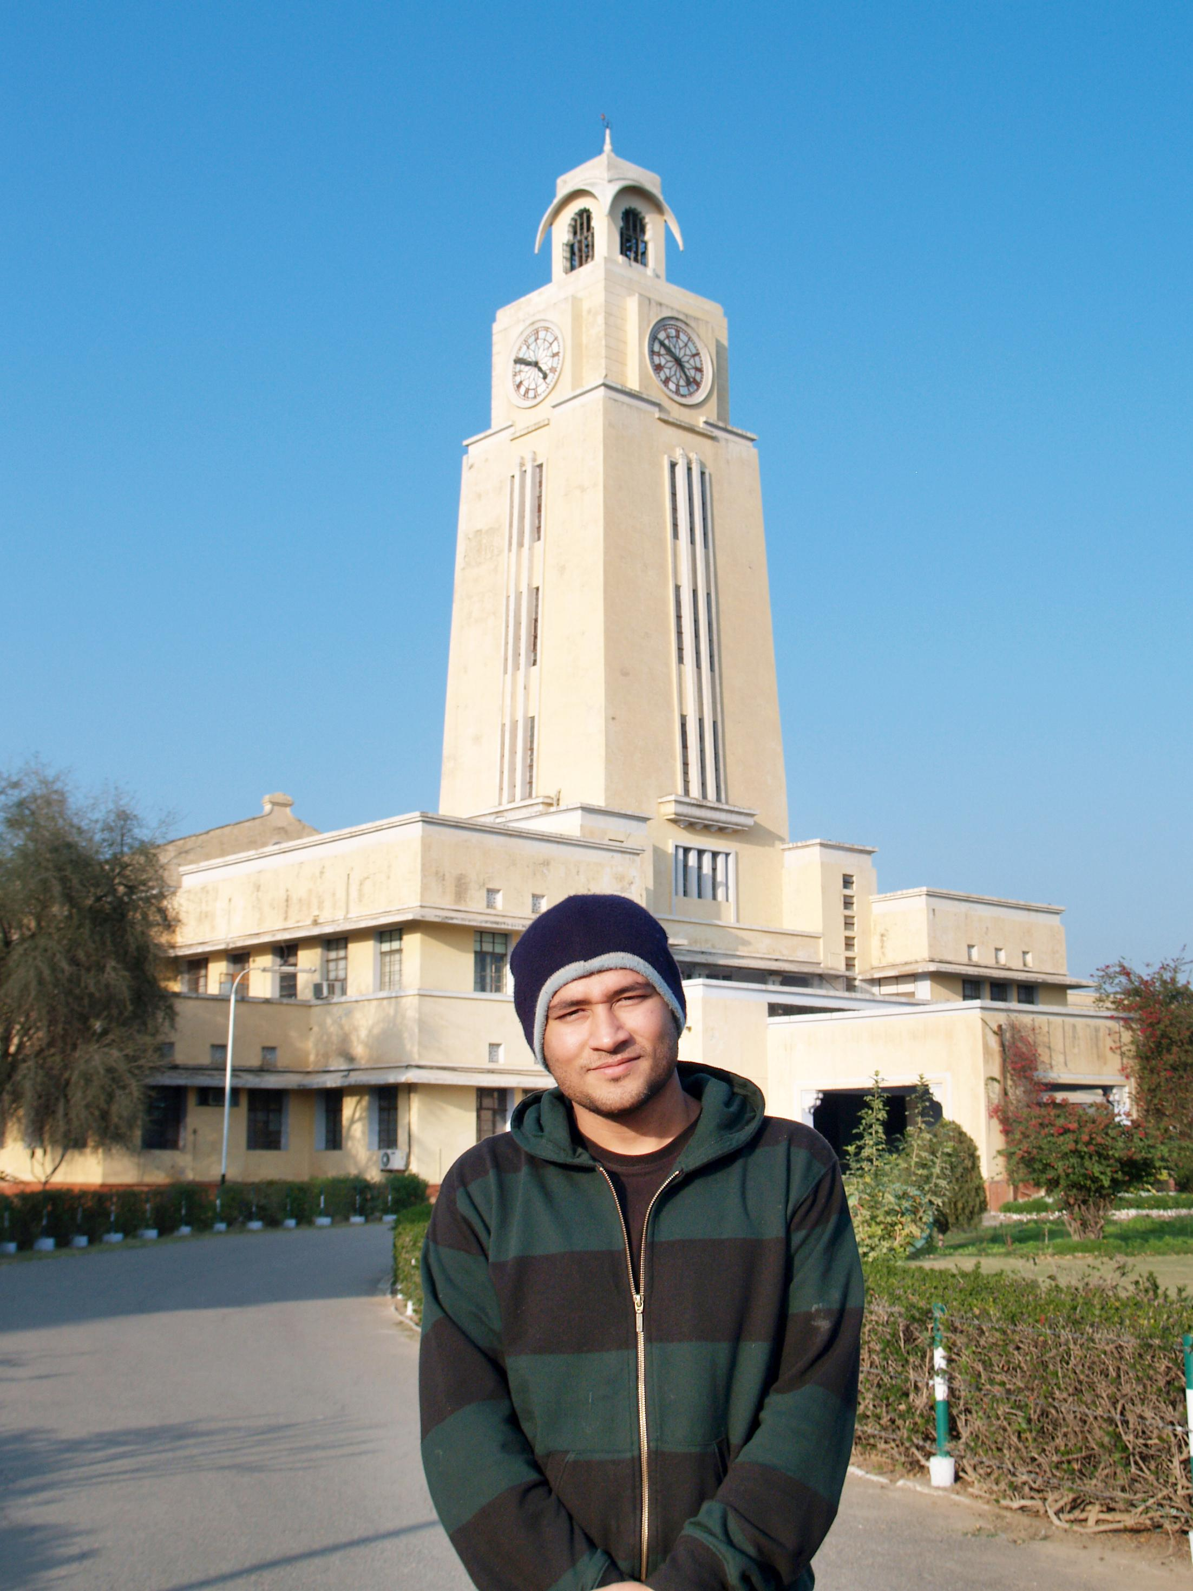

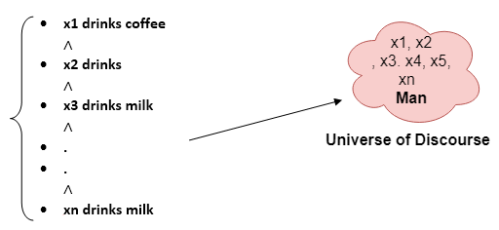

BITS Pilani
Pilani Campus
(some slides adapted from Stuart http://aima.cs.berkeley.edu/)
DSE CL 557 - Artificial and Computational Intelligence
#11. Inference in First Order Logic
Sunday, December 13, 2020
Dr. Saikishor Jangiti

Slide 2
Today
Inference in FOL
Unification & Lifting
Forward chaining
Backward Chaining
Resolution
Reference: Chapter 9 from AI: A modern approach (Russell, Norvig)

Slide 3
Universal instantiation (UI)
Every instantiation of a universally quantified sentence is entailed by it:
∀v α Subst({v/g}, α)
for any variable v and ground term g
E.g., ∀x King(x) ∧ Greedy(x) ⇒ Evil(x) yields:
King(John) ∧ Greedy(John) ⇒ Evil(John)
King(Richard) ∧ Greedy(Richard) ⇒ Evil(Richard)
King(Father(John)) ∧ Greedy(Father(John)) ⇒ Evil(Father(John))
.
.
.

Slide 4
Existential instantiation (EI)
For any sentence α, variable v, and constant symbol k that does not appear elsewhere in the knowledge base:
∃v α
Subst({v/k}, α)
E.g., ∃x Crown(x) ∧ OnHead(x,John) yields:
Crown(C₁) ∧ OnHead(C₁,John)
provided C₁ is a new constant symbol, called a Skolem constant

Slide 5
Reduction to propositional inference
Suppose the KB contains just the following:
∀x King(x) ∧ Greedy(x) ⇒ Evil(x)
King(John)
Greedy(John)
Brother(Richard,John)
Instantiating the universal sentence in all possible ways, we have:
King(John) ∧ Greedy(John) ⇒ Evil(John)
King(Richard) ∧ Greedy(Richard) ⇒ Evil(Richard)
King(John)
Greedy(John)
Brother(Richard,John)
The new KB is propositionalized: proposition symbols are
King(John), Greedy(John), Evil(John), King(Richard), etc.

Slide 6
Reduction contd.
Every FOL KB can be propositionalised so as to preserve entailment
(A ground sentence is entailed by new KB iff entailed by original KB)
Idea: propositionalize KB and query, apply resolution, return result
Problem: with function symbols, there are infinitely many ground terms,
e.g., Father(Father(Father(John)))

Slide 7
Reduction contd.
Theorem: Herbrand (1930). If a sentence α is entailed by an FOL KB, it is entailed by a finite subset of the propositionalized KB
Idea: For n = 0 to ∞ do
create a propositional KB by instantiating with depth-$n$ terms
see if α is entailed by this KB
Problem: works if α is entailed, loops if α is not entailed
Theorem: Turing (1936), Church (1936) Entailment for FOL is semidecidable (algorithms exist that say yes to every entailed sentence, but no algorithm exists that also says no to every nonentailed sentence.)

Slide 8
Problems with propositionalization
Propositionalization seems to generate lots of irrelevant sentences.
E.g., from:
∀x King(x) ∧ Greedy(x) ⇒ Evil(x)
King(John)
∀y Greedy(y)
Brother(Richard,John)
it seems obvious that Evil(John), but propositionalization produces lots of facts such as Greedy(Richard) that are irrelevant
With p k-ary predicates and n constants, there are p·n^{k} instantiations.

Slide 9
Unification
We can get the inference immediately if we can find a substitution θ such that King(x) and Greedy(x) match King(John) and Greedy(y)
θ = {x/John, y/John} works
Unify(α,β) = θ if αθ = βθ
p q θ
Knows(John,x) Knows(John,Jane)
Knows(John,x) Knows(y,OJ)
Knows(John,x) Knows(y,Mother(y))
Knows(John,x) Knows(x,OJ)
Standardizing apart eliminates overlap of variables, e.g., Knows(z₁₇,OJ)

Slide 10
Unification
We can get the inference immediately if we can find a substitution θ such that King(x) and Greedy(x) match King(John) and Greedy(y)
θ = {x/John,y/John} works
Unify(α,β) = θ if αθ = βθ
p q θ
Knows(John,x) Knows(John,Jane) {x/Jane}}
Knows(John,x) Knows(y,OJ)
Knows(John,x) Knows(y,Mother(y))
Knows(John,x) Knows(x,OJ)
Standardizing apart eliminates overlap of variables, e.g., Knows(z₁₇,OJ)

Slide 11
Unification
We can get the inference immediately if we can find a substitution θ such that King(x) and Greedy(x) match King(John) and Greedy(y)
θ = {x/John,y/John} works
Unify(α,β) = θ if αθ = βθ
p q θ
Knows(John,x) Knows(John,Jane) {x/Jane}}
Knows(John,x) Knows(y,OJ) {x/OJ,y/John}}
Knows(John,x) Knows(y,Mother(y))
Knows(John,x) Knows(x,OJ)
Standardizing apart eliminates overlap of variables, e.g., Knows(z₁₇,OJ)

Slide 12
Unification
We can get the inference immediately if we can find a substitution θ such that King(x) and Greedy(x) match King(John) and Greedy(y)
θ = {x/John,y/John} works
Unify(α,β) = θ if αθ = βθ
p q θ
Knows(John,x) Knows(John,Jane) {x/Jane}}
Knows(John,x) Knows(y,OJ) {x/OJ,y/John}}
Knows(John,x) Knows(y,Mother(y)) {y/John,x/Mother(John)}}
Knows(John,x) Knows(x,OJ)
Standardizing apart eliminates overlap of variables, e.g., Knows(z₁₇,OJ)

Slide 13
Unification
We can get the inference immediately if we can find a substitution θ such that King(x) and Greedy(x) match King(John) and Greedy(y)
θ = {x/John,y/John} works
Unify(α,β) = θ if αθ = βθ
p q θ
Knows(John,x) Knows(John,Jane) {x/Jane}}
Knows(John,x) Knows(y,OJ) {x/OJ,y/John}}
Knows(John,x) Knows(y,Mother(y)) {y/John,x/Mother(John)}}
Knows(John,x) Knows(x,OJ) {fail}
Standardizing apart eliminates overlap of variables, e.g., Knows(z₁₇,OJ)

Slide 14
Unification
To unify Knows(John,x) and Knows(y,z),
θ = {y/John, x/z } or θ = {y/John, x/John, z/John}
The first unifier is more general than the second.
There is a single most general unifier (MGU) that is unique up to renaming of variables.
MGU = { y/John, x/z }

Slide 15
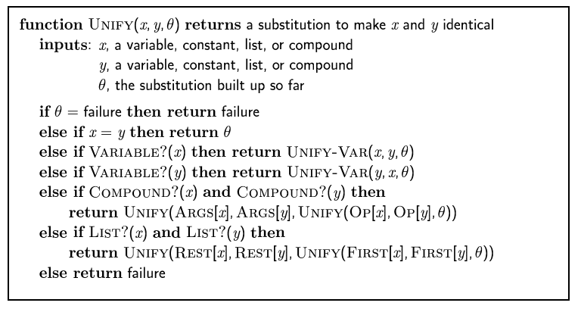
The unification algorithm

Slide 16
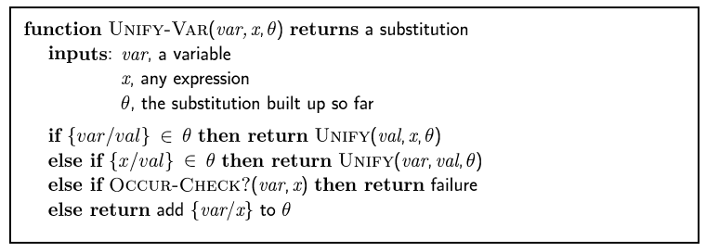
The unification algorithm

Slide 17
Generalized Modus Ponens (GMP)
p₁', p₂', … , p_{n}', ( p₁ ∧ p₂ ∧ … ∧ p_{n} ⇒q)
qθ
p₁' is King(John) p₁ is King(x)
p₂' is Greedy(y) p₂ is Greedy(x)
θ is {x/John,y/John} q is Evil(x)
q θ is Evil(John)
GMP used with KB of definite clauses (exactly one positive literal)
All variables assumed universally quantified
where p_{i}'θ = p_{i} θ for all i

Slide 18
Soundness of GMP
Need to show that
p₁', …, p_{n}', (p₁ ∧ … ∧ p_{n} ⇒ q) ╞ qθ
provided that p_{i}'θ = p_{i}θ for all I
Lemma: For any sentence p, we have p ╞ pθ by UI
(p₁ ∧ … ∧ p_{n} ⇒ q) ╞ (p₁ ∧ … ∧ p_{n} ⇒ q)θ = (p₁θ ∧ … ∧ p_{n}θ ⇒ qθ)
p₁', \; …, \;p_{n}' ╞ p₁' ∧ … ∧ p_{n}' ╞ p₁'θ ∧ … ∧ p_{n}'θ
From 1 and 2, qθ follows by ordinary Modus Ponens

Slide 19
Example knowledge base
The law says that it is a crime for an American to sell weapons to hostile nations. The country Nono, an enemy of America, has some missiles, and all of its missiles were sold to it by Colonel West, who is American.
Prove that Col. West is a criminal

Slide 20
Example knowledge base contd.
... it is a crime for an American to sell weapons to hostile nations:
American(x) ∧ Weapon(y) ∧ Sells(x,y,z) ∧ Hostile(z) ⇒ Criminal(x)
Nono … has some missiles, i.e., ∃x Owns(Nono,x) ∧ Missile(x):
Owns(Nono,M₁) and Missile(M₁)
… all of its missiles were sold to it by Colonel West
Missile(x) ∧ Owns(Nono,x) ⇒ Sells(West,x,Nono)
Missiles are weapons:
Missile(x) ⇒ Weapon(x)
An enemy of America counts as "hostile“:
Enemy(x,America) ⇒ Hostile(x)
West, who is American …
American(West)
The country Nono, an enemy of America …
Enemy(Nono,America)

Slide 21
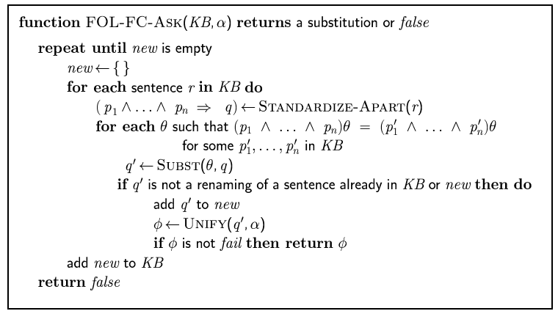
Forward chaining algorithm

Slide 22
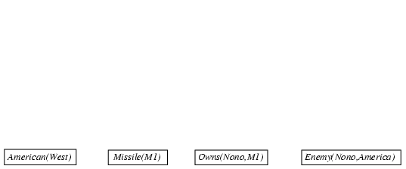
Forward chaining proof

Slide 23
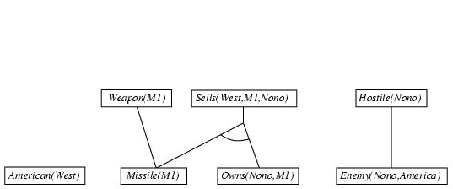
Forward chaining proof

Slide 24
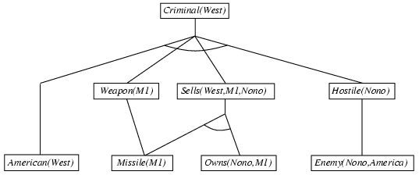
Forward chaining proof

Slide 25
Properties of forward chaining
Sound and complete for first-order definite clauses
Datalog = first-order definite clauses + no functions
FC terminates for Datalog in finite number of iterations
May not terminate in general if α is not entailed
This is unavoidable: entailment with definite clauses is semidecidable

Slide 26
Efficiency of forward chaining
Incremental forward chaining: no need to match a rule on iteration k if a premise wasn't added on iteration k-1
⇒ match each rule whose premise contains a newly added positive literal
Matching itself can be expensive:
Database indexing allows O(1) retrieval of known facts
e.g., query Missile(x) retrieves Missile(M₁)
Forward chaining is widely used in deductive databases

Slide 27
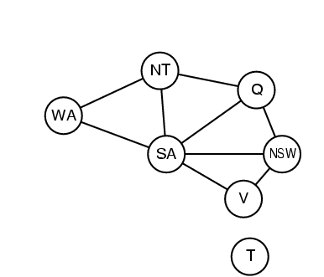
Hard matching example
Diff(wa,nt) ∧ Diff(wa,sa) ∧ Diff(nt,q) ∧ Diff(nt,sa) ∧ Diff(q,nsw) ∧ Diff(q,sa) ∧ Diff(nsw,v) ∧ Diff(nsw,sa) ∧ Diff(v,sa) ⇒ Colorable()
Diff(Red,Blue) Diff (Red,Green) Diff(Green,Red) Diff(Green,Blue) Diff(Blue,Red) Diff(Blue,Green)
Colorable() is inferred iff the CSP has a solution
CSPs include 3SAT as a special case, hence matching is NP-hard

Slide 28
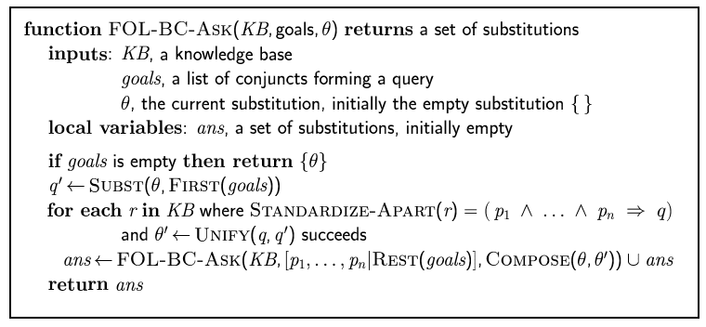
Backward chaining algorithm
SUBST(COMPOSE(θ₁, θ₂), p) = SUBST(θ₂, SUBST(θ₁, p))

Slide 29

Backward chaining example

Slide 30
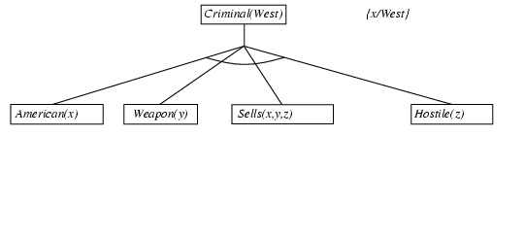
Backward chaining example

Slide 31
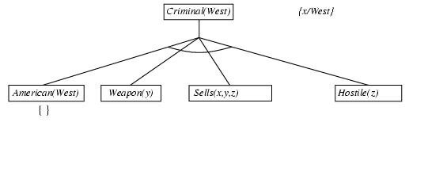
Backward chaining example

Slide 32
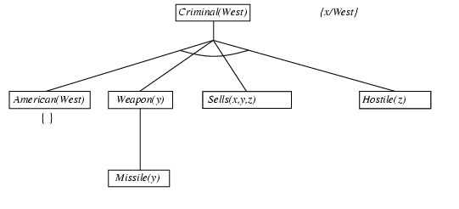
Backward chaining example

Slide 33
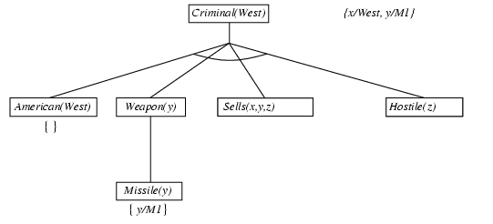
Backward chaining example

Slide 34
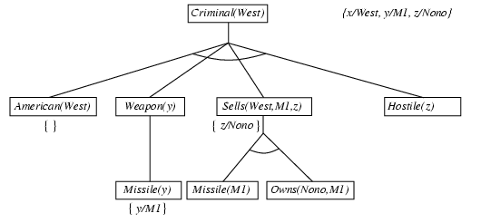
Backward chaining example

Slide 35
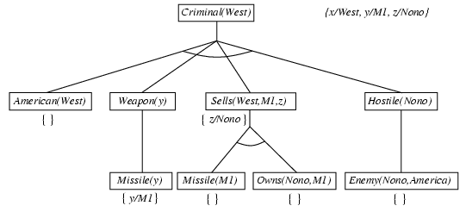
Backward chaining example

Slide 36
Backward chaining example

Slide 37
Properties of backward chaining
Depth-first recursive proof search: space is linear in size of proof
Incomplete due to infinite loops
⇒ fix by checking current goal against every goal on stack
Inefficient due to repeated subgoals (both success and failure)
⇒ fix using caching of previous results (extra space)
Widely used for logic programming

Slide 38
Logic programming: Prolog
Algorithm = Logic + Control
Basis: backward chaining with Horn clauses + bells & whistles
Widely used in Europe, Japan (basis of 5th Generation project)
Compilation techniques ⇒ 60 million LIPS
Program = set of clauses = head :- literal₁, … literal_{n}.
criminal(X) :- american(X), weapon(Y), sells(X,Y,Z), hostile(Z).
Depth-first, left-to-right backward chaining
Built-in predicates for arithmetic etc., e.g., X is Y*Z+3
Built-in predicates that have side effects (e.g., input and output
predicates, assert/retract predicates)
Closed-world assumption ("negation as failure")
e.g., given alive(X) :- not dead(X).
alive(joe) succeeds if dead(joe) fails

Slide 39
Prolog
Appending two lists to produce a third:
append([],Y,Y).
append([X|L],Y,[X|Z]) :- append(L,Y,Z).
query: append(A,B,[1,2]) ?
answers: A=[] B=[1,2]
A=[1] B=[2]
A=[1,2] B=[]

Slide 40
Resolution: brief summary
Full first-order version:
l₁ ∨ ··· ∨ l_{k}, m₁ ∨ ··· ∨ m_{n}
(l₁ ∨ ··· ∨ l_{i-1} ∨ l_{i+1} ∨ ··· ∨ l_{k} ∨ m₁ ∨ ··· ∨ m_{j-1} ∨ m_{j+1} ∨ ··· ∨ m_{n})θ
where Unify(l_{i}, ¬m_{j}) = θ.
The two clauses are assumed to be standardized apart so that they share no variables.
For example,
¬Rich(x) ∨ Unhappy(x)
Rich(Ken)
Unhappy(Ken) with θ = {x/Ken}
Apply resolution steps to CNF(KB ∧ ¬α); complete for FOL

Slide 41
Conversion to CNF
Everyone who loves all animals is loved by someone:
∀x [∀y Animal(y) ⇒ Loves(x,y)] ⇒ [∃y Loves(y,x)]
1. Eliminate biconditionals and implications
∀x [¬∀y ¬Animal(y) ∨ Loves(x,y)] ∨ [∃y Loves(y,x)]
2. Move ¬ inwards: ¬∀x p ≡ ∃x ¬p, ¬ ∃x p ≡ ∀x ¬p
∀x [∃y ¬(¬Animal(y) ∨ Loves(x,y))] ∨ [∃y Loves(y,x)]
∀x [∃y ¬¬Animal(y) ∧ ¬Loves(x,y)] ∨ [∃y Loves(y,x)]
∀x [∃y Animal(y) ∧ ¬Loves(x,y)] ∨ [∃y Loves(y,x)]

Slide 42
Conversion to CNF contd.
Standardize variables: each quantifier should use a different one
∀x [∃y Animal(y) ∧ ¬Loves(x,y)] ∨ [∃z Loves(z,x)]
Skolemize: a more general form of existential instantiation.
Each existential variable is replaced by a Skolem function of the enclosing universally quantified variables:
∀x [Animal(F(x)) ∧ ¬Loves(x,F(x))] ∨ Loves(G(x),x)
Drop universal quantifiers:
[Animal(F(x)) ∧ ¬Loves(x,F(x))] ∨ Loves(G(x),x)
Distribute ∨ over ∧ : [Animal(F(x)) ∨ Loves(G(x),x)] ∧ [¬Loves(x,F(x)) ∨ Loves(G(x),x)]

Slide 43
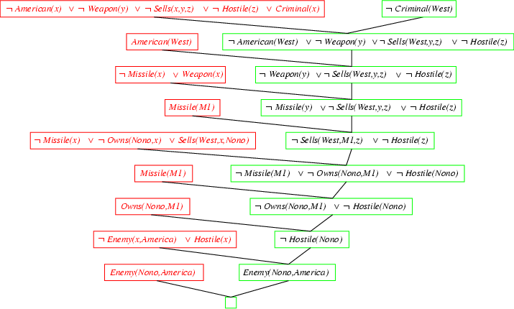
Resolution proof: definite clauses

Slide 44
Thank you for your Attention
Any more queries

